Slide 1

Churn Risk Score Prediction by Implementing Artificial Neural Network
Abi Rahman Sugiri

Slide 2
Introduction
Problem
Objective

Slide 3

Exploratory Data Analysis
Checking Data types
Checking for Missing Values
Inspecting Data Patterns
Identifying basic Data Statistics
Plotting Charts

Slide 4
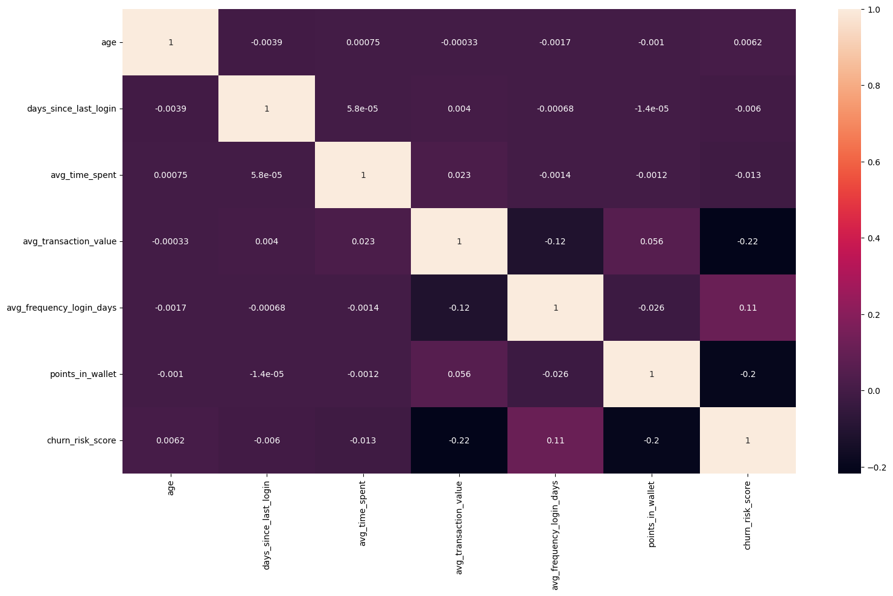

Slide 5
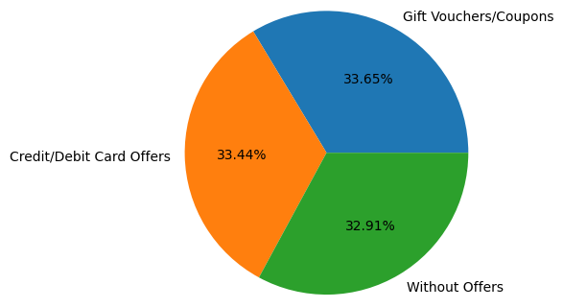
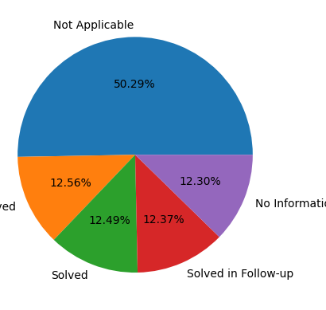
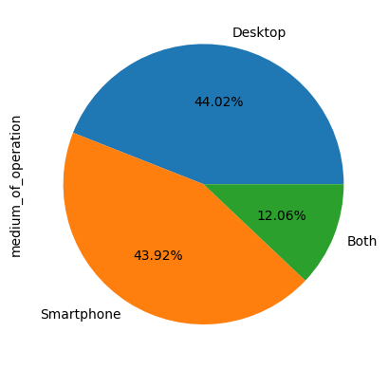
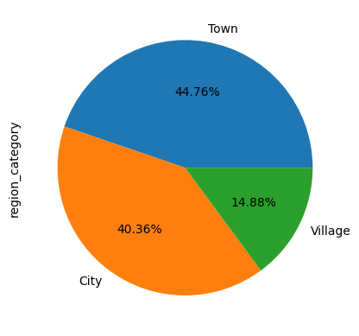
Pie Charts

Slide 6

Artificial Neural Network (ANN)
Sequential API
Input Layer 51 Neurons
Hidden layer #1: 64 neurons, axon: tanh, Initializer: Glorot Uniform
Hidden layer #2: 16 neurons, axon: relu, Initializer: He Normal
Output : axon: sigmoid, Initializer: Glorot Normal
Compiler: Cross Entropy, optimizer: nadam
Epoch: 150
Sequential API
51 Neurons
Hidden layer #1: 64 neurons, axon: tanh, Initializer: Glorot Uniform
Hidden layer #2: 16 neurons, axon: relu, Initializer: He Normal
Concate: Input Layer and Hidden Layer #2
Output : axon: sigmoid, Initializer: Glorot Normal
Compiler: Cross Entropy, optimizer: nadam

Slide 7
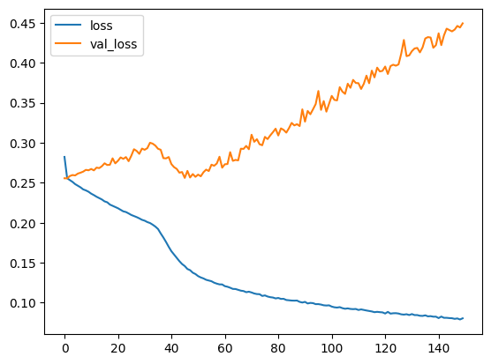
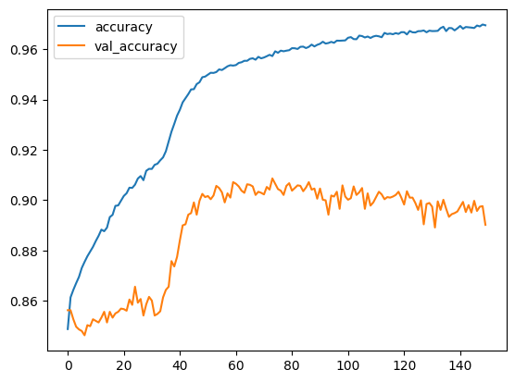
Sequential API

Slide 8
Sequential API
 | Precision | Recall | F1-Score
0 | 0.87 | 0.90 | 0.88
1 | 0.91 | 0.89 | 0.90
Accuracy |  |  | 0.89

Slide 9
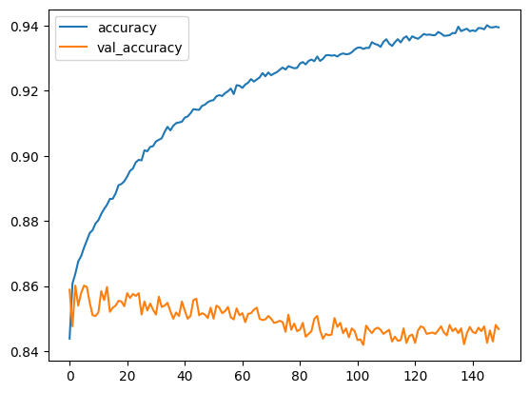
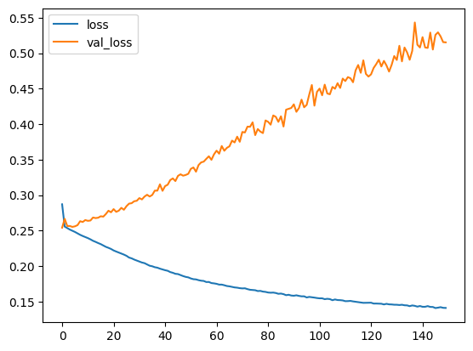
Functional API

Slide 10
Functional API
 | Precision | Recall | F1-Score
0 | 0.83 | 0.83 | 0.83
1 | 0.86 | 0.87 | 0.96
Accuracy |  |  | 0.85

Slide 11
Model Improvement of ANN
Sequential API
Hidden layer #1: 128 neurons, axon: tanh, Initializer: Glorot Uniform
Hidden layer #2: 64 neurons, axon: relu, Initializer: He Normal
Hidden layer #3: 8 neurons, axon: relu, Initializer: He Normal
Output : axon: sigmoid, Initializer: Glorot Normal
Compiler: Cross Entropy, optimizer: SGD
Epoch: 200
Sequential API
Hidden layer #1: 64 neurons, axon: tanh, Initializer: Glorot Uniform
Hidden layer #2: 32 neurons, axon: relu, Initializer: He Normal
Hidden layer #3: 8 neurons, axon: relu, Initializer: He Normal
Concate: Hidden Layer #2 and Hidden Layer #3
Output : axon: sigmoid, Initializer: Glorot Normal
Compiler: Cross Entropy, optimizer: SGD

Slide 12
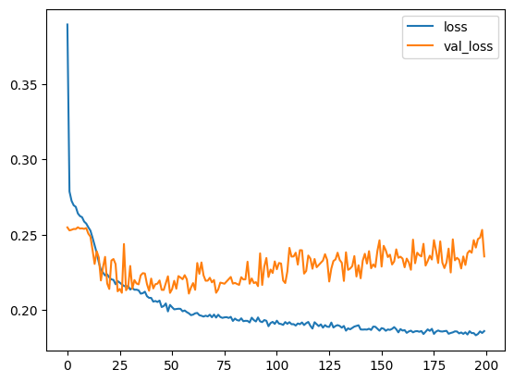
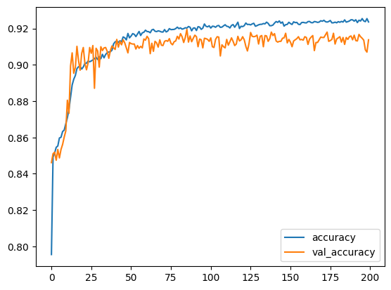
Sequential API (Improved)

Slide 13
Sequential API (Improved)
 | Precision | Recall | F1-Score
0 | 0.95 | 0.86 | 0.90
1 | 0.89 | 0.96 | 0.93
Accuracy |  |  | 0.92

Slide 14
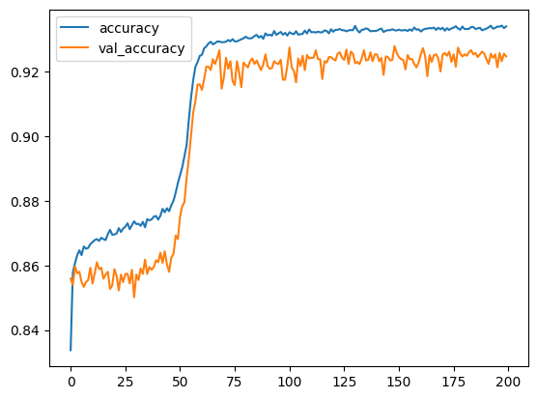
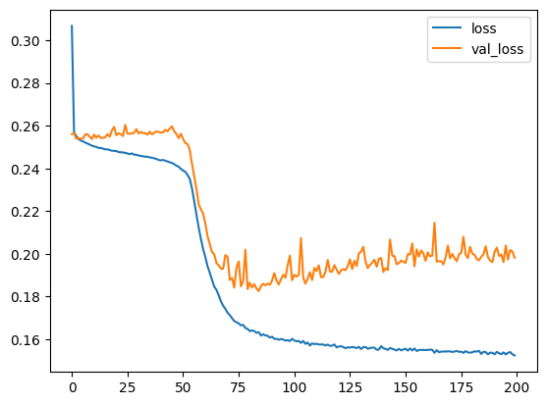
Functional API (Improved)

Slide 15
Functional API (Improved)
 | Precision | Recall | F1-Score
0 | 0.95 | 0.88 | 0.91
1 | 0.91 | 0.96 | 0.93
Accuracy |  |  | 0.92

Slide 16
Thank You

